Slide 1

MODERN TOUCH SOLUTIONS
Social Media Strategy
& Content Roadmap
Qualified inbound leads from the Philadelphia Main Line
Prepared for Brax Stover and Storyy | September 2026
Notes:
Client imagery sourced from Modern Touch Solutions: https://www.moderntouchsolutions.com/

Slide 2
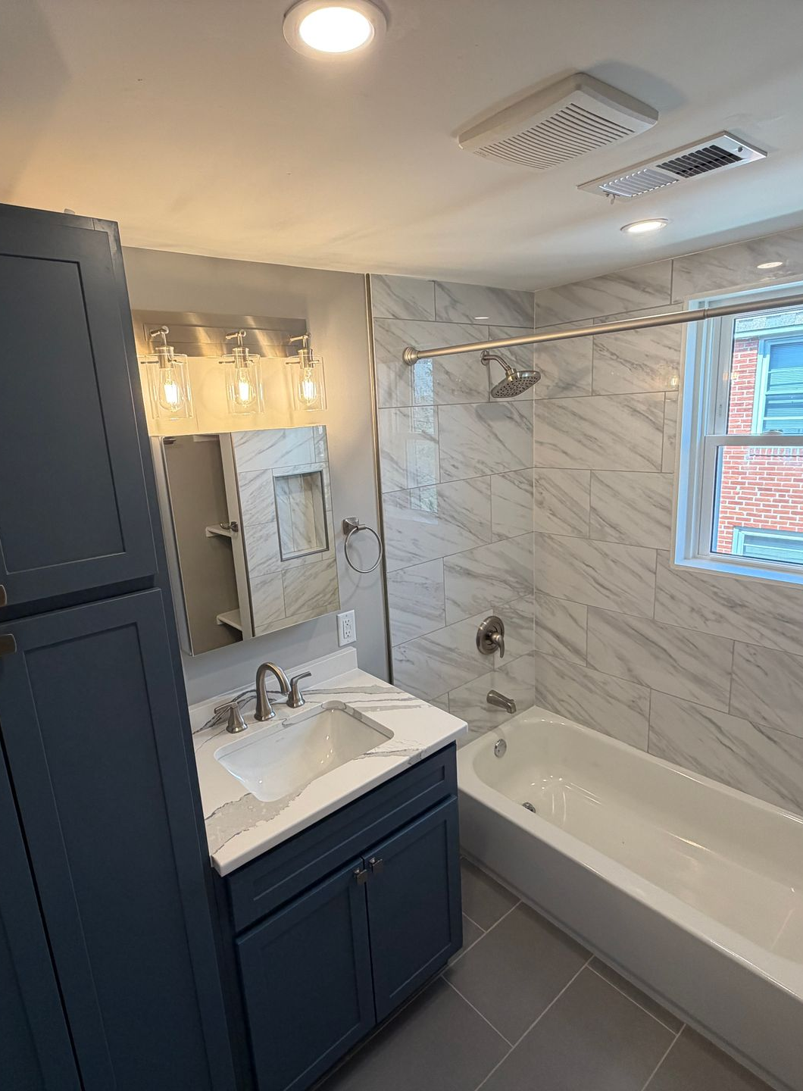
SECTION 01
Profile Analysis
& Optimization
A new visitor should understand the service area, the work, and the next step within seconds.
MODERN TOUCH SOLUTIONS
02
Notes:
Client imagery sourced from Modern Touch Solutions: https://www.moderntouchsolutions.com/

Slide 3
PROFILE ANALYSIS
Profile identity
01
02
03
Username
Profile name
Profile photo
Standardize @moderntouchsolutions across Instagram, Facebook, and TikTok. Avoid extra words or location abbreviations unless the clean handle is unavailable.
Use “Modern Touch Solutions | Main Line Contractor.” The searchable location and service category should appear in the name field, not only in the bio.
Use the clean MTS mark on a high contrast background. Keep Brax as the face of the videos, while the profile image makes the business easy to recognize.
MODERN TOUCH SOLUTIONS
03

Slide 4
PROFILE ANALYSIS
Profile conversion
CALL TO ACTION
RECOMMENDED BIO
Use “Request a free remodeling quote” in the bio and every pinned post.
Main Line remodeling contractor
Kitchens • Baths • Basements • Exteriors
Owner on site daily | PA #159191
Free quote ↓
LINK IN BIO
Send visitors directly to the quote page, not the website homepage.
CONTACT
Turn on call and email buttons. Match the phone number across every profile.
UNIQUE EDGE
Owner-led oversight and direct communication from walkthrough to final punch list.
HIGHLIGHTS AND PINS
Highlights: Start Here, Kitchens, Baths, Basements, Exteriors, Reviews. Pins: Brax intro, best transformation, quote process.
MODERN TOUCH SOLUTIONS
04

Slide 5
PROFILE ANALYSIS
Platform-specific optimization
Instagram
PRIMARY SHOWROOM
Use location-rich captions, consistent orange covers, three pinned trust posts, and daily job-site Stories when footage is available.
Facebook
HOMEOWNER REACH
Cross-post every Reel. Complete the service area, reviews, quote button, and project albums for homeowners aged 35 to 65.
TikTok
LOCAL DISCOVERY
Keep edits raw and founder-led. Put the town and service in the opening text, spoken hook, and caption for search visibility.
MODERN TOUCH SOLUTIONS
05

Slide 6
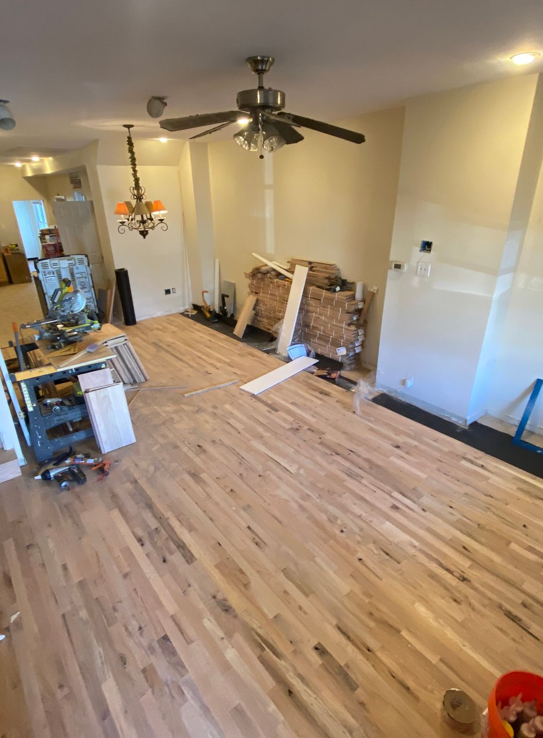
SECTION 02
Content Roadmap
Four pillars balance visible proof, useful expertise, local personality, and clear reasons to request a quote.
MODERN TOUCH SOLUTIONS
06
Notes:
Client imagery sourced from Modern Touch Solutions: https://www.moderntouchsolutions.com/

Slide 7
SOCIAL PROOF & RESULTS
Before-and-after transformations
Show the transformation and the workmanship that makes a homeowner comfortable requesting a quote.
PILLAR 1
01
02
03
HOOK
HOOK
HOOK
“This Wayne kitchen had one problem nobody could ignore.”
“We turned this Conshohocken basement into usable square footage.”
“A small Main Line bathroom can still feel custom.”
VIDEO IDEA
VIDEO IDEA
VIDEO IDEA
Open on the bottleneck, reveal the new layout, then show Brax explaining the single change that fixed the room.
Walk from the unfinished entry into the finished space with three fast before-and-after matches.
Show the old footprint, the tile and storage choices, then the final wide shot.
MODERN TOUCH SOLUTIONS
07

Slide 8
SOCIAL PROOF & RESULTS
Proof in the details
Show the transformation and the workmanship that makes a homeowner comfortable requesting a quote.
PILLAR 1
01
02
03
HOOK
HOOK
HOOK
“The most important part of this bathroom will never be seen again.”
“A beautiful replacement window can still leak.”
“This tiny cabinet gap tells me who installed the kitchen.”
VIDEO IDEA
VIDEO IDEA
VIDEO IDEA
Brax points out waterproofing before tile and explains the failure it prevents.
Show flashing, sealant, and drainage details during a Wayne window install.
Use close-ups to explain level lines, reveals, and final alignment.
MODERN TOUCH SOLUTIONS
08

Slide 9
SOCIAL PROOF & RESULTS
Homeowner confidence
Show the transformation and the workmanship that makes a homeowner comfortable requesting a quote.
PILLAR 1
01
02
03
HOOK
HOOK
HOOK
“The best part of this Wayne remodel was the homeowner's reaction.”
“They said we left the house cleaner than we found it.”
“Your contractor should show you this before asking for final payment.”
VIDEO IDEA
VIDEO IDEA
VIDEO IDEA
Film the reveal with permission, then cut to the finished details they mention.
Pair a real review with protection, cleanup, and completed work footage.
Brax walks the punch list and explains the closeout process.
MODERN TOUCH SOLUTIONS
09

Slide 10
EDUCATION & AUTHORITY
Before you hire
Explain the decisions behind the work so Main Line homeowners recognize a contractor who knows the details.
PILLAR 2
01
02
03
HOOK
HOOK
HOOK
“Ask these questions before you hire a Main Line contractor.”
“A one-line estimate is a warning, not a shortcut.”
“The low bid gets expensive when this is missing.”
VIDEO IDEA
VIDEO IDEA
VIDEO IDEA
Brax covers license, insurance, scope clarity, and who supervises the site.
Compare a vague estimate with a clear scope without showing client information.
Explain allowances, change orders, and hidden exclusions with a real project example.
MODERN TOUCH SOLUTIONS
10

Slide 11
EDUCATION & AUTHORITY
Old Main Line homes
Explain the decisions behind the work so Main Line homeowners recognize a contractor who knows the details.
PILLAR 2
01
02
03
HOOK
HOOK
HOOK
“Open a wall in a 1940s Wayne home and expect this.”
“Old Main Line homes rarely give you square walls.”
“Before we disturb paint in an older home, this comes first.”
VIDEO IDEA
VIDEO IDEA
VIDEO IDEA
Point out old wiring, framing changes, or plumbing surprises and how the team responds.
Show scribing, shimming, or trim work that creates a clean finished line.
Explain lead-safe setup and the value of EPA-certified work.
MODERN TOUCH SOLUTIONS
11

Slide 12
EDUCATION & AUTHORITY
Materials and methods
Explain the decisions behind the work so Main Line homeowners recognize a contractor who knows the details.
PILLAR 2
01
02
03
HOOK
HOOK
HOOK
“We pay more for this material because callbacks cost more.”
“The fastest way to ruin a bathroom happens before tile.”
“Siding only performs as well as the layers behind it.”
VIDEO IDEA
VIDEO IDEA
VIDEO IDEA
Compare the chosen product with the cheaper option and explain the performance difference.
Show substrate prep, waterproofing, and cure time in sequence.
Brax points to the weather barrier, flashing, and ventilation during install.
MODERN TOUCH SOLUTIONS
12

Slide 13
AUTHENTICITY & COMMUNITY
Crew chemistry
Let homeowners meet Brax and the crew while building a recognizable neighborhood contractor presence.
PILLAR 3
01
02
03
HOOK
HOOK
HOOK
“If a Main Line remodel was filmed like a workplace sitcom.”
“Live from the job site with the world's most expensive microphone.”
“POV: You own the company and still get handed a tool.”
VIDEO IDEA
VIDEO IDEA
VIDEO IDEA
Use quick reaction cuts around a harmless tool mix-up, then finish on clean project proof.
Use a drill or level as a prop mic for one-question crew interviews.
A crew member catches Brax looking busy and sends him back into the work.
MODERN TOUCH SOLUTIONS
13

Slide 14
AUTHENTICITY & COMMUNITY
Behind the build
Let homeowners meet Brax and the crew while building a recognizable neighborhood contractor presence.
PILLAR 3
01
02
03
HOOK
HOOK
HOOK
“What happens before a Wayne job site wakes up.”
“A full day of remodeling in 20 seconds.”
“Our job is not done when the tools go back in the truck.”
VIDEO IDEA
VIDEO IDEA
VIDEO IDEA
Film arrival, protection, layout review, and the first task in four short clips.
Capture the same camera angle at morning, midday, and cleanup for visible progress.
Show cleanup, walkthrough, and punch-list checks at closeout.
MODERN TOUCH SOLUTIONS
14

Slide 15
AUTHENTICITY & COMMUNITY
Main Line neighborhood stories
Let homeowners meet Brax and the crew while building a recognizable neighborhood contractor presence.
PILLAR 3
01
02
03
HOOK
HOOK
HOOK
“Wayne homes keep giving us this same renovation challenge.”
“Buying near Fayette Street? Check this before you renovate.”
“Today's project is five minutes from downtown Wayne.”
VIDEO IDEA
VIDEO IDEA
VIDEO IDEA
Connect a common layout or age-related issue to a current project.
Share one practical inspection or planning tip for Conshohocken buyers.
Open with a recognizable local landmark, then move straight to the job site.
MODERN TOUCH SOLUTIONS
15

Slide 16
CONVERSION & OFFERS
The quote process
Remove uncertainty around the next step and give qualified homeowners a reason to start the conversation.
PILLAR 4
01
02
03
HOOK
HOOK
HOOK
“Here is what happens after you request a free quote.”
“Want a more accurate remodeling quote? Bring these two things.”
“A good proposal should answer this before work starts.”
VIDEO IDEA
VIDEO IDEA
VIDEO IDEA
Brax explains the call, walkthrough, scope, and proposal in four fast steps.
Ask homeowners for priorities and inspiration photos before the walkthrough.
Show how scope, materials, schedule, and communication appear in the plan.
MODERN TOUCH SOLUTIONS
16

Slide 17
CONVERSION & OFFERS
Common homeowner concerns
Remove uncertainty around the next step and give qualified homeowners a reason to start the conversation.
PILLAR 4
01
02
03
HOOK
HOOK
HOOK
“Can you live in the house during a remodel? Sometimes.”
“What actually delays a renovation on the Main Line.”
“Why the cheapest estimate can cost the most.”
VIDEO IDEA
VIDEO IDEA
VIDEO IDEA
Explain dust control, work zones, utilities, and when moving out makes sense.
Cover selections, hidden conditions, and change orders with real examples.
Explain missing scope, rework, and communication without attacking competitors.
MODERN TOUCH SOLUTIONS
17

Slide 18
CONVERSION & OFFERS
Offers and timely needs
Remove uncertainty around the next step and give qualified homeowners a reason to start the conversation.
PILLAR 4
01
Community discount
Brax explains the 10% offer for veterans and first responders with a direct quote CTA.
02
Exterior readiness
Inspect roofing, windows, and doors before winter hits the Main Line.
03
24/7 emergency response
Explain what homeowners should share when a leak cannot wait until Monday.
MODERN TOUCH SOLUTIONS
18

Slide 19
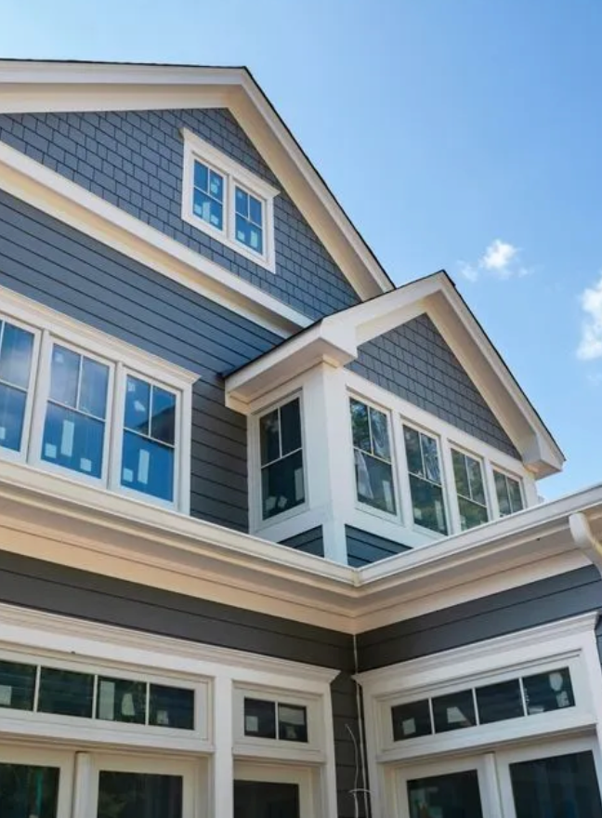
SECTION 03
Niche Neighbors
Borrow the content mechanics that build trust, then localize every idea for Wayne, Conshohocken, and the Main Line.
MODERN TOUCH SOLUTIONS
19
Notes:
Client imagery sourced from Modern Touch Solutions: https://www.moderntouchsolutions.com/

Slide 20
COMPETITIVE INSPIRATION
Niche neighbor benchmarks
Matt Risinger
Kyle Stumpenhorst
Perkins Builder Brothers
@risingerbuild
@rrbuildings
@perkins_builder_brothers
WHAT WORKS
WHAT WORKS
WHAT WORKS
Build-science authority
Clear product opinions
Founder-led explanations
Raw site progress
Satisfying process
Founder as narrator
Crew personalities
Useful explanations
Long-running projects
TOP CONTENT
TOP CONTENT
TOP CONTENT
Details and failures
Material comparisons
Site walkthroughs
Time-lapse builds
Tool demos
Progress reveals
Crew banter
Problem solving
Build episodes
Est. daily
Est. 3-5x weekly
Est. 3-5x weekly
APPLY: Explain the why | Keep Brax on camera | Turn crew moments into recurring formats
MODERN TOUCH SOLUTIONS
20
Notes:
Reference profiles: https://linktr.ee/risingerbuild and https://rrbuildings.com/instagram/. Posting frequency is an estimate and should be rechecked during monthly competitive audits.

Slide 21
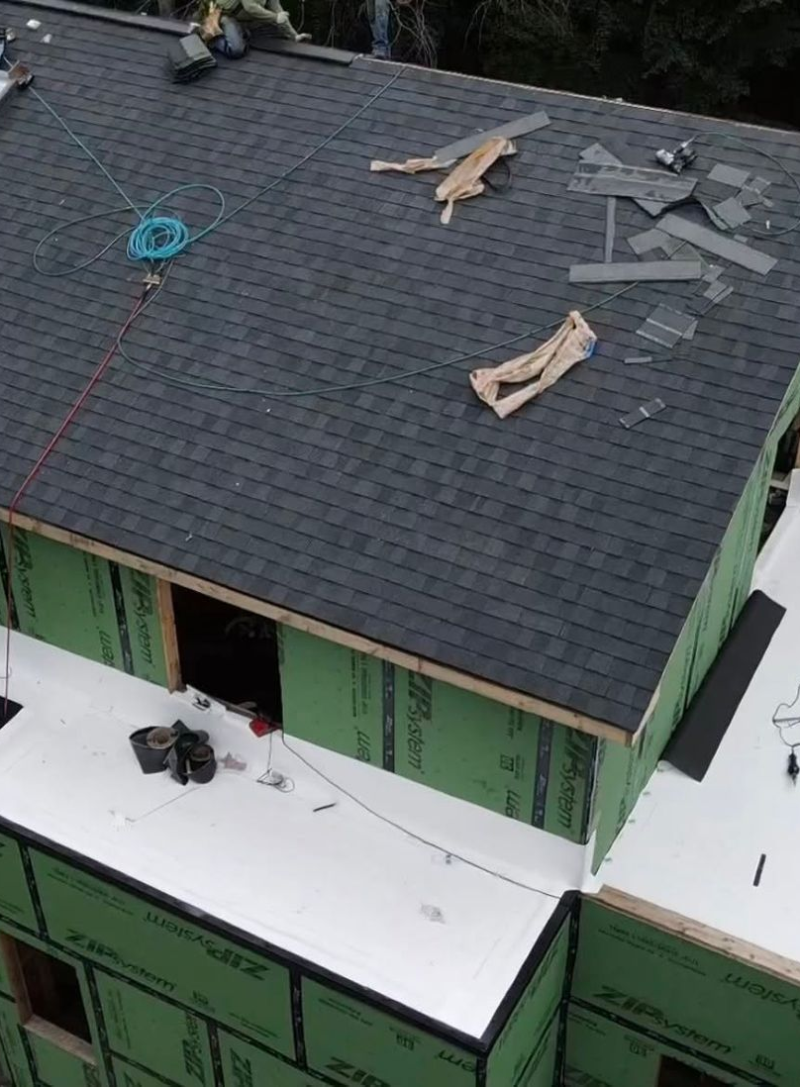
SECTION 04
Posting Strategy
A sustainable weekly rhythm gives every project several chances to build trust and produce a quote request.
MODERN TOUCH SOLUTIONS
21
Notes:
Client imagery sourced from Modern Touch Solutions: https://www.moderntouchsolutions.com/

Slide 22
POSTING STRATEGY
Weekly publishing rhythm
MON
7:30 PM ET
REEL
Education or planning
TUE
Stories
BTS
Quick job-site updates
WED
7:30 PM ET
REEL
Transformation or proof
THU
Stories
Q&A
Poll or project question
FRI
6:30 PM ET
REEL
Crew, community, or offer
SUN
7:00 PM ET
CAROUSEL
Review, guide, or FAQ
Short-form posts publish to Instagram Reels, Facebook Reels, and TikTok. Brax records one job-site batch each week. Storyy edits, captions, schedules, and reports.
MODERN TOUCH SOLUTIONS
22

Slide 23
POSTING STRATEGY
Sample weekly content calendar
DAY
HOOK
STRATEGIC GOAL
MON
“Ask this before hiring a Main Line contractor.”
Build authority
TUE
“What happens before this Wayne job site wakes up.”
Humanize the crew
WED
“This Conshohocken basement became usable square footage.”
Prove results
THU
“What would you change first in this kitchen?”
Create engagement
FRI
“POV: The owner gets caught working again.”
Grow local reach
SUN
“Five remodel phrases that change the scope.”
Earn saves and inquiries
MODERN TOUCH SOLUTIONS
23

Slide 24
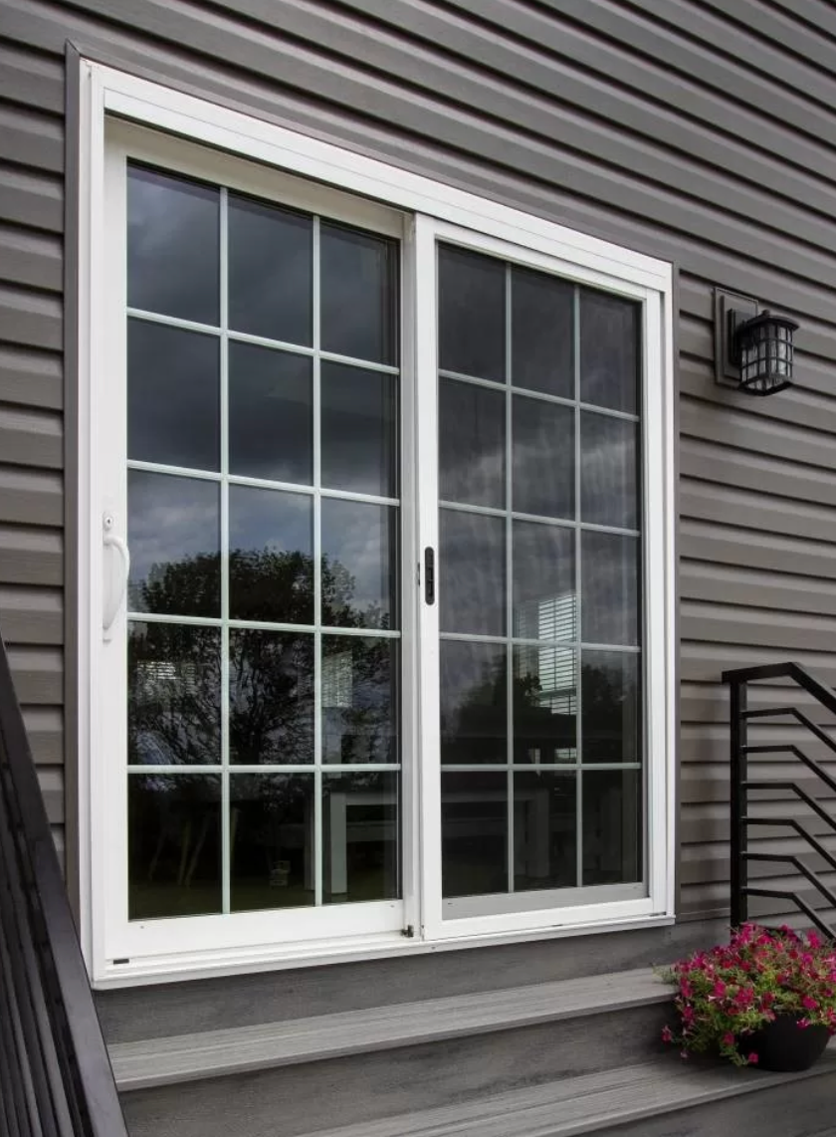
SECTION 05
Social Media Updates
The workflow should protect Brax's time while improving local discoverability and content consistency.
MODERN TOUCH SOLUTIONS
24
Notes:
Client imagery sourced from Modern Touch Solutions: https://www.moderntouchsolutions.com/

Slide 25
SOCIAL MEDIA UPDATES
Updates to apply now
PLATFORM UPDATE
WHAT'S NEW
NEXT STEP
TikTok search insights
Creator Search Insights surfaces popular topics and content gaps.
Check local remodeling searches monthly, then turn useful terms into hooks and captions.
WORKFLOW UPDATE
WHAT'S NEW
NEXT STEP
One shoot, three platforms
Each vertical edit should work on Instagram, Facebook, and TikTok without a watermark.
Capture clean source footage once and tailor the first caption line for each platform.
STRATEGY UPDATE
WHAT'S NEW
NEXT STEP
Local proof beats broad reach
Town names, recognizable homes, and real project details attract better-fit viewers.
Name Wayne, Conshohocken, or the exact Main Line community whenever permission allows.
MODERN TOUCH SOLUTIONS
25
Notes:
TikTok source: https://newsroom.tiktok.com/creator-search-insights/?lang=en. Strategy recommendations also reflect the Modern Touch Solutions content brief and current workflow.

Slide 26

SECTION 06
Action Items
The next two weeks should produce a clear profile, a repeatable footage pipeline, and the first month of publish-ready content.
MODERN TOUCH SOLUTIONS
26
Notes:
Client imagery sourced from Modern Touch Solutions: https://www.moderntouchsolutions.com/

Slide 27
CLIENT ACTION ITEMS
Brax: next actions
01
Confirm profile details
Approve the handle, profile name, recommended bio, quote link, phone number, and discount wording.
02
Record one weekly batch
Capture 12 to 15 vertical clips on one active job site. Include Brax, one crew moment, progress details, and a clean reveal.
03
Share proof assets
Upload current before-and-afters, three recent reviews, crew names, project towns, and any homeowner permissions to Dropbox.
MODERN TOUCH SOLUTIONS
27

Slide 28
CSM ACTION ITEMS
Storyy: next actions
01
Update the profiles
Apply the approved bio, searchable name field, direct quote link, contact buttons, highlights, and pinned-post structure.
02
Build the first content batch
Turn the next Dropbox upload into three Reels and one carousel. Use the orange five-star cover system across the batch.
03
Track qualified demand
Report quote-link clicks, direct inquiries, calls, saves, and the town tied to each lead. Use views only as supporting context.
MODERN TOUCH SOLUTIONS
28

